Slide 1
A short introduction to the
Battery Programming Box V2
Date: January 17, 2022

Slide 2
Overview
Device Overview
Basic Capabilities
Batteries Supported
Connections
Basic commands
Advanced commands
Firmware updates
SharePoint Site

Slide 3
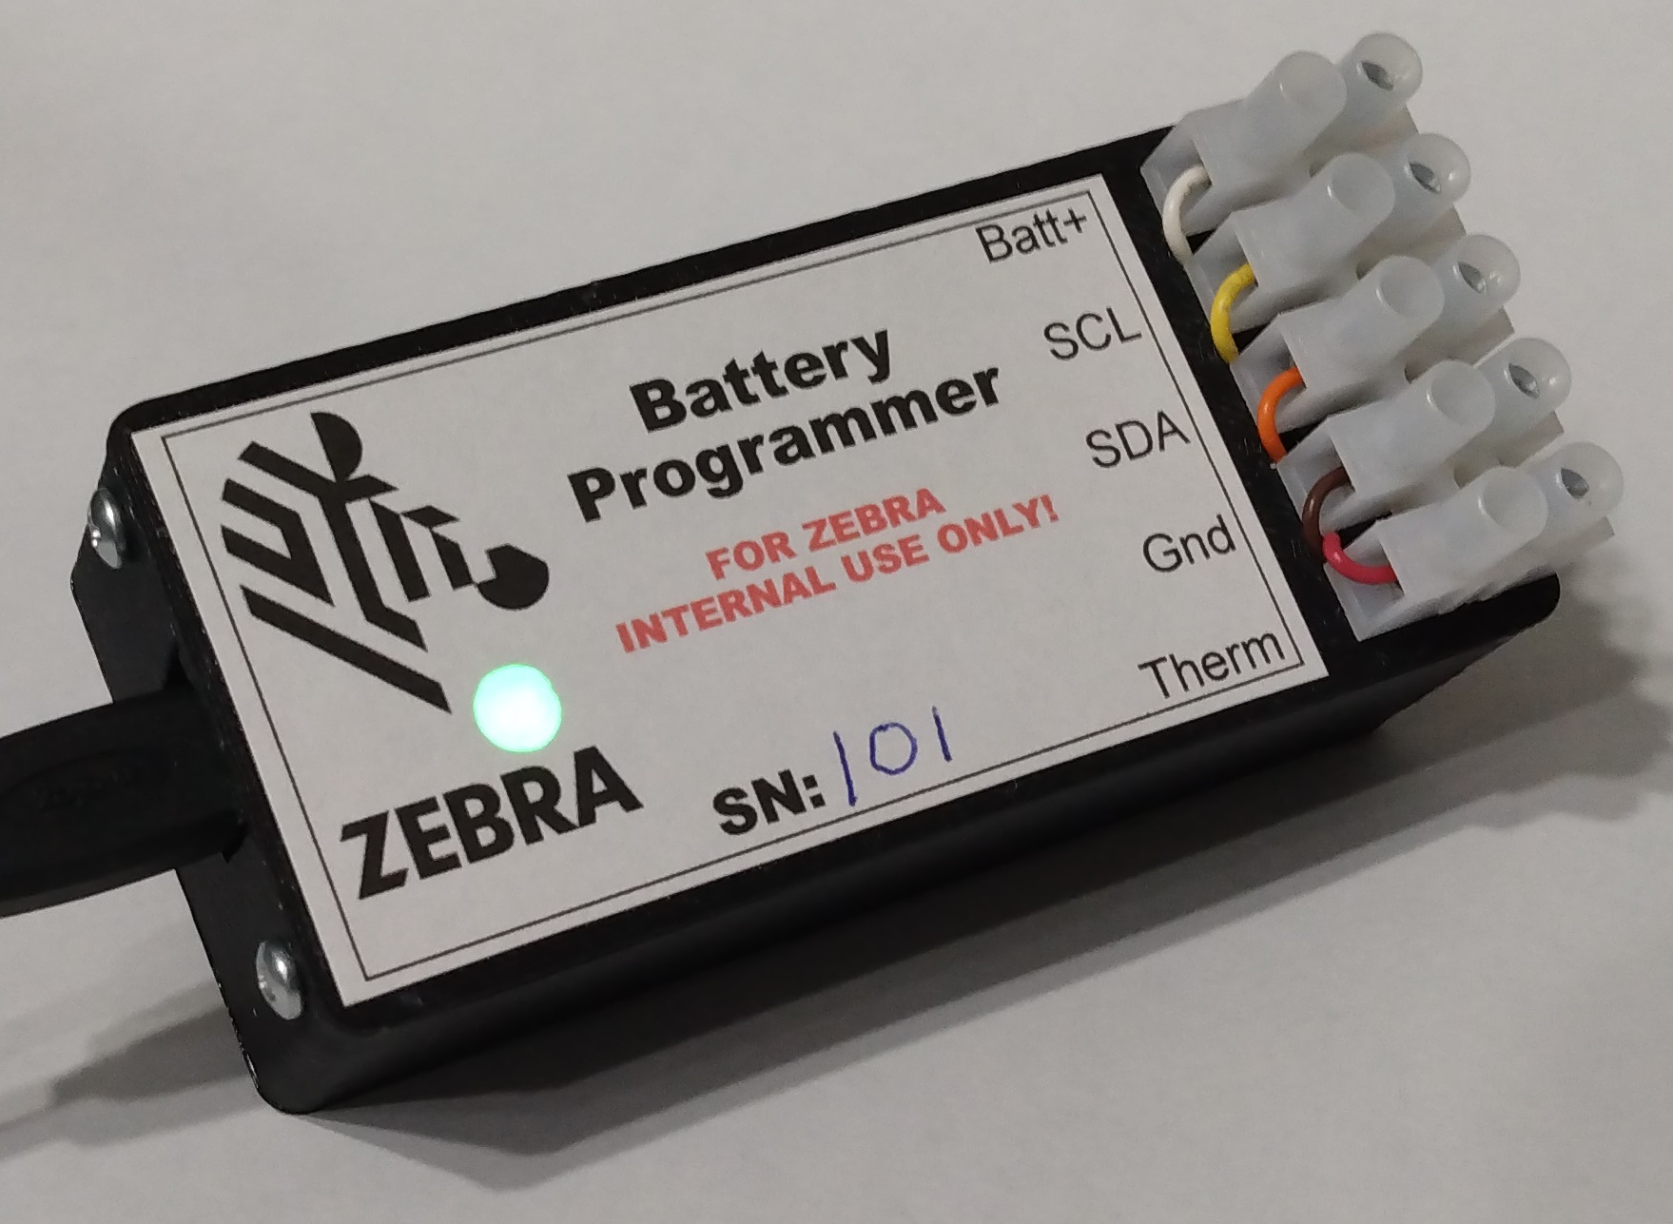
Device Overview
Small device used to access and program battery ICs
Reads/writes EEPROM, Auth IC, and Gas Gauges
USB interface to PC
Supports most Zebra terminal battery types
Can support zebra printer batteries
Status LED shows connection status and indicates when it’s accessing a battery

Slide 4
Basic Capabilities
Import battery EEPROM/Auth IC file data onto your PC
Display battery EEPROM/Auth IC data
  Part number and revision, JEITA data, etc.
Display gas gauge data
  Cycle count, accumulated charge
  Time since first use, status registers, etc.
Update/replace EEPROM/Auth IC data
Validate battery data to check for errors
Authenticate the auth IC
Display battery voltage and thermistor resistance

Slide 5
Batteries Supported
MPA2 Smart Batteries (MC33 legacy)
Pollux batts (TC70)
PP+ Batts (TC70X, TC51, TC8000, MC18, etc.)
Value tier (TC21, MC22, etc.)
PP+ V2 (New GG) (Jaws, etc.)
Hardware support for BLE battery
  Simulate terminal power modes (on, off, suspended)
  Simulate battery in & out of terminal
Hardware can support Zebra printer 2 cell packs

Slide 6
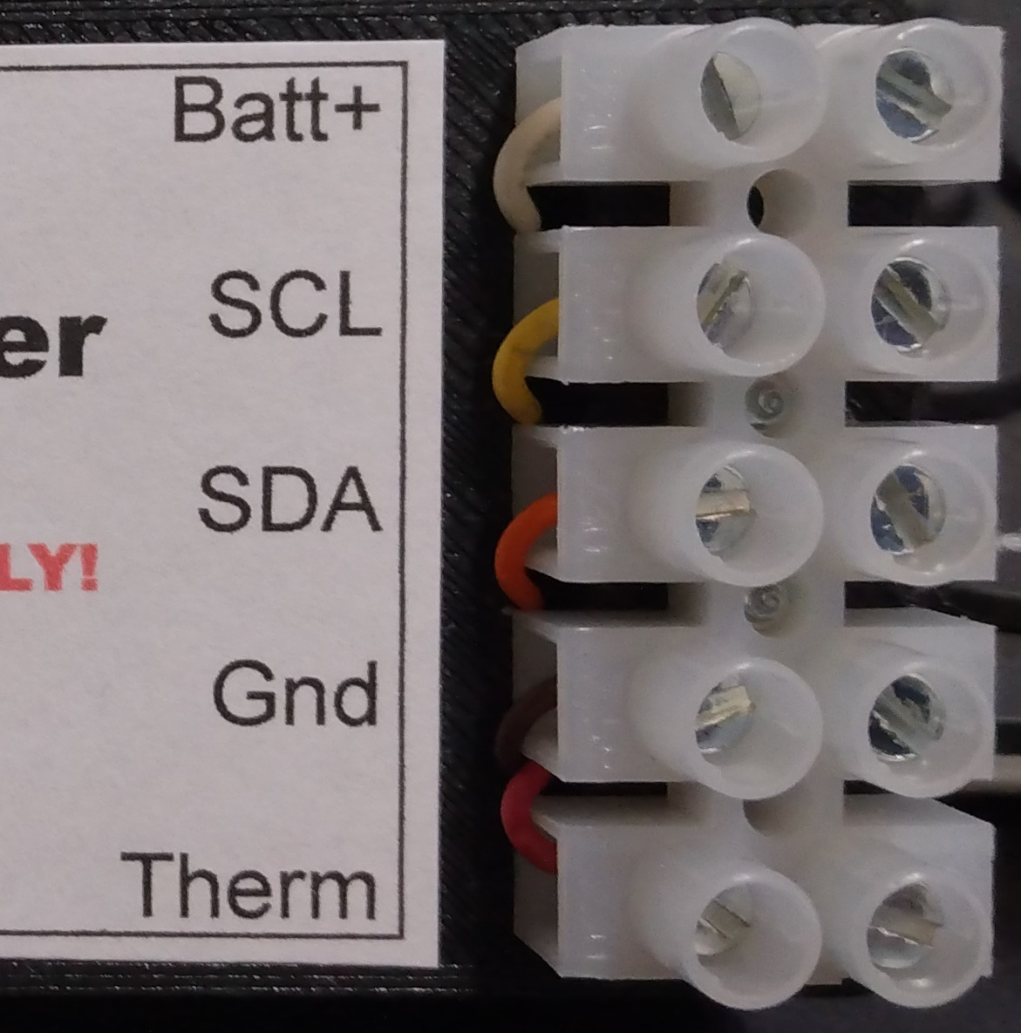
Connections
Micro USB cable to PC
  Box appears as a USB serial port
    Use a serial terminal program like TeraTerm
    Simple command line interface
  Also appears as a 2MB USB flash drive
    Drag/drop files to/from the box
Battery connections
  Batt+, SCL, SDA, Gnd, and thermistor

Slide 7
Basic Commands
? – Context sensitive help menu
B – Select battery type
VBD – Validate battery data (Same process as terminal)
DPP – Display Power Precision battery data
DPP+ – Display Power Precision Plus battery data
DGG – Display gas gauge data
RE/RA – Read EEPROM/Auth IC into buffer
WE/WA – Program EEPROM/Auth IC from buffer
UE/UA – Update EEPROM/Auth IC from buffer
  Does not erase data written during manufacture
SF – Save buffer to a file on internal drive
LF – Load buffer from a file on internal drive

Slide 8
Advanced Commands
SGGF – Save gas gauge flash to a hex file
HGG – Hibernate gas gauge
RGG – Reset gas gauge
USGG – Unseal gas gauge
FUSGG – Fully unseal gas gauge
DGGH – Display gas gauge registers in hex
UGG – Update gas gauge
Plan is to support BLE battery going forward
  Read BLE micro firmware version, etc.
  Trigger BLE beacon for testing

Slide 9
Firmware Updates
Latest firmware is on SharePoint site
UF ‘Update Firmware’ command triggers update
Device will restart and connect to USB as a flash drive
Drag and drop the new firmware file onto the drive
Device will restart with updated code

Slide 10
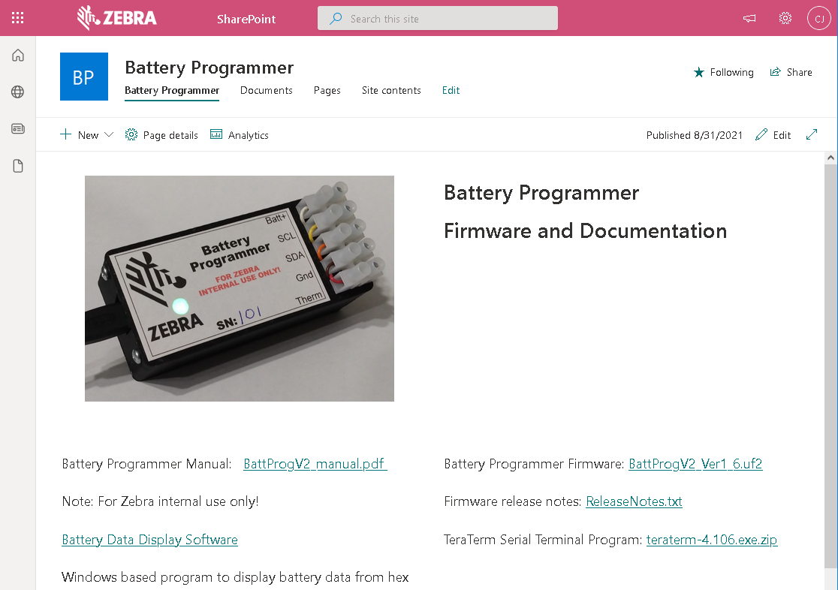
SharePoint Site
https://zebra.sharepoint.com/sites/BatteryProgrammer
Manual in PDF
TeraTerm install program
Windows Battery Data Display program
  Display battery data from a hex file
  Only works with EEPROM/Auth data
Latest firmware and release notes

Slide 11
Questions?

